Slide 1


Ayman Moumen
https://github.com/Ayman2G
March 25, 2022

Slide 2
Outline
Executive Summary
Introduction
Methodology
Results
Conclusion
Appendix
2

Slide 3
Executive Summary
Summary of methodologies:
API
Web Scraping
Data Wrangling
Data Analysis and Exploration Using:
SQL
Data Visualization
Folium
Machine Learning Prediction
Summary of all results:
Data Analysis and Exploration Results
Prediction Comparison and Results
3

Slide 4
Introduction
Project background and context
SpaceX advertises Falcon 9 rocket launches on its website with a cost of 62 million dollars; other providers cost upward of 165 million dollars each, much of the savings is because Space X can reuse the first stage. Therefore if we can determine if the first stage will land, we can determine the cost of a launch. This information can be used if an alternate company wants to bid against SpaceX for a rocket launch. This Capstone Project goes through the entire process and culminates in creating a machine learning pipeline that predicts if the first stage will land, given the data.
Problems you want to find answers
Where there were successful and unsuccessful landings
What can impact the success/fail rate and what are tied to them
What are the patterns, which can be used, and how they influence
4

Slide 5

Section 1
5

Slide 6
Methodology
Executive Summary
Data collection methodology:
Utilized API and Web Scraping
Performed data wrangling
Only Falcon 9 data was used; one-hot-encoding for non-numerical categories
Performed exploratory data analysis (EDA) using visualization and SQL
Performed interactive visual analytics using Folium and Plotly Dash
Performed predictive analysis using classification models
Explored launch sites, orbits, payloads and success/failure rates

Slide 7
Data Collection
SpaceX API was used to collect data on:
Booster Version
Launch Site
Payload Mass
Core (the reusable booster)
Web Scraping was used to collect data on Falcon 9 Launch Data on:
Flight number, Date and Time
Booster Version and Landing
Launch Site
Payload and Payload Mass
Orbit Destination

Slide 8
Data Collection – SpaceX API
Data was pulled from SpaceX API using the requests method, normalized, and a specific data frame created with only Falcon 9 launches and certain columns. That included checking for, removing and replacing missing values with the mean, where applicable.
SpaceX Falcon 9 launches
Spacex API
SpaceX DB
requests.get
Data Collection – SpaceX API Github
Jupyter Notebook
Data frame
.json, normalize

Slide 9
Data Collection - Scraping
Data was pulled from a Wikipedia table with Falcon 9 launches using the requests method. A BeautifulSoup object was created, columns identified, a dictionary created in order to parse the information and create a data frame.
SpaceX Falcon 9 launches
Spacex API
SpaceX DB
Jupyter Notebook
Data frame
Wikipedia
requests.get
Data Collection - Scraping Github
BeautifulSoup

Slide 10
Data Wrangling
Identified and determined the number of launches on each site and orbits
Utilized launches’ respective success and failure outcomes, and thus, their rates
Data frame
Data wrangling Github
Success: 1
Failure: 0
Launch sites? Orbits?
Create Label: Outcome
Data frame
Successes? Failures?

Slide 11
EDA with Data Visualization
Seaborn was used to explore the relationships below:
Categorization between Flight number/ Payload Mass, Launch Site
Scatter plot for Payload Mass/Launch Site, Flight Number/Orbit and Payload Mass/Orbit
Matplotlib was used to visualize:
Using bars, the relationship between Success Rate and Orbit Type
Using a line, the Yearly Trend of launch successes
EDA with Data Visualization Github

Slide 12
EDA with SQL
The names of all the unique launch sites in the space mission
Five records of launch sites beginning with “CCA”
Total payload mass carried by NASA (CRS) boosters
Average payload mass carried by F9 v1.1 booster
Date of the first successful landing on a ground pad
Boosters that successfully landed in a drone ship with payload between 4000 and 6000 Kg
Total number of successful and failed mission outcomes
The name of booster versions which have carried the maximum payload
Records which show month names, failed landing outcomes in drone ships, booster versions, launch site name for the months in 2015
Rank the amount of successful landings between 04-06-2010 and 20-03-2017 in descending order
EDA with SQL Github
12

Slide 13
Build an Interactive Map with Folium
Markers and circles were created for all launch sites to visualize their national positioning
Each site has its own set of marker cluster showing the successful and failed launch locations to deliver a visual of the success rate at each site and their specific positions
Two lines were drawn from a launch site: one, to a marker delimiting the closest coastline and a second to a major highway intersection. It can be shown how far they are from hazardous activity such as launching rockets a launch site
Folium Interactive Map Github

Slide 14
Build a Dashboard with Plotly Dash
Interactive Dashboard, so you can choose different launch sites (or all of them combined) and payload masses
Visuals such as a pie chart to see the amount of launches per site and a scatter plot which changes with the payload mass to observe how mass changes which booster is used
Plotly Dashboard Github

Slide 15

Predictive Analysis (Classification)
Started with creating an array with NumPy using the column Class from the data frame to get y, then standardized and transformed to get x
Obtained training and test data with 0.2 for parameter and random state to 2, ending with 18 test samples
Proceeded to evaluate using Logistic Regression, Support Vector Machine, KNN and Decision Trees and their respective accuracy and confusion matrices, allowing to pick the best model
Predictive Analysis Github
LR
X, Y
Conclusion
SVM
Most Accurate?
Data frame
KNN
Training Data
(Parameter = 0.2 Random State = 2)
DT
15

Slide 16
Results
Exploratory data analysis results
Interactive analytics demo in screenshots
Predictive analysis results
16

Slide 17

Section 2

Slide 18
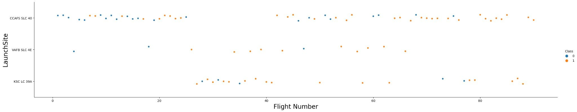
Flight Number vs. Launch Site
With blue dots being failed landings, and orange dots being successful landings, below we see a trend of increasing success rate with higher flight numbers across all launch sites:

Slide 19
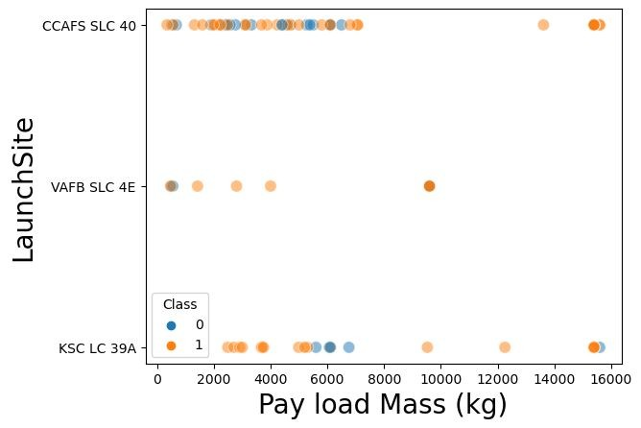
Payload vs. Launch Site
In this scatter plot, which uses the same blue/orange color key as the previous one, CCAFS SLC 40 shows to be used more than any other launch site, regardless of payload mass – however, with a payload gap between 8000 Kg and 14000 Kg with no launches recorded;
Coming in second as far as usage is concerned, the KSL LC 39A also displays a better payload spread;
Lastly, VAFB SLC 4E is at last place for usage, with even greater payload gaps between 5000 Kg and 10000 Kg, and over 11000 Kg, approximately.

Slide 20
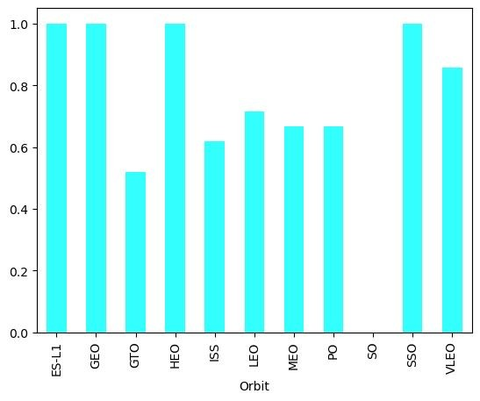
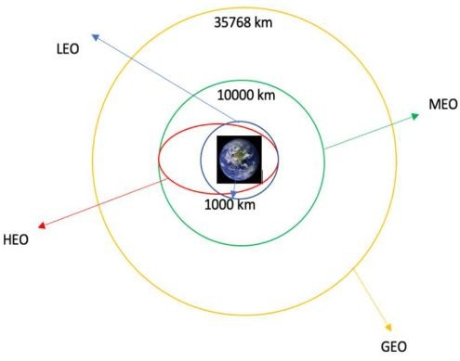
Success Rate vs. Orbit Type
The bar graph to the right shows the success rate per Orbit type (although some soccer fans would argue it’s Argentina’s World Cup result);
Standing out with the best success rates, from left to right, we have ES-L1, GEO, HEO and SSO (see graph below for a few orbit distances for reference)

Slide 21
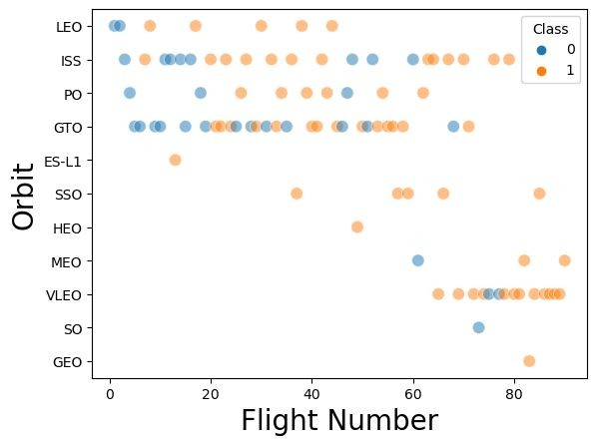
Flight Number vs. Orbit Type
In this graph, using the same color key as before, we can see the same increase in success rate as the flight number increases;
However, there seems to not be a correlation between orbit types and success rate
Moreover, GTO is a commonly used orbit, since the payload is aligned with the equator

Slide 22
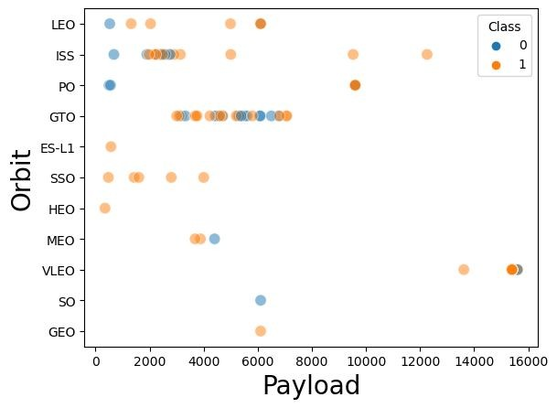
Payload vs. Orbit Type
Again, with the same color key, it is noticeable that GTO has a well-defined payload range between just below 4000 Kg and just below 8000 Kg;
SSO has a few, but all success landings with payloads of less than 6000 Kg;
ISS also displays a good cluster between 2000 and 4000 Kg with mixed outcomes;
As a whole, we can infer from this graph that heavier payloads are fewer, but with a higher success rate.

Slide 23
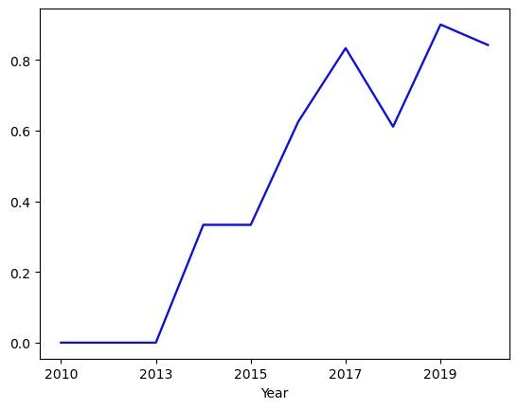
Launch Success Yearly Trend
In the line graph to the right, it’s clear that the success rate is trading in a positive way.
Considering the payload mass, launch site, weather, other factors, and the fact that they are reusable rockets, one can say it is a successful technology.

Slide 24
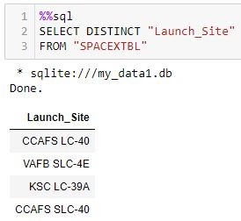
All Launch Site Names
Task: Find the names of the unique launch sites
The DISTINCT command was used to ensure only unique values would be called

Slide 25
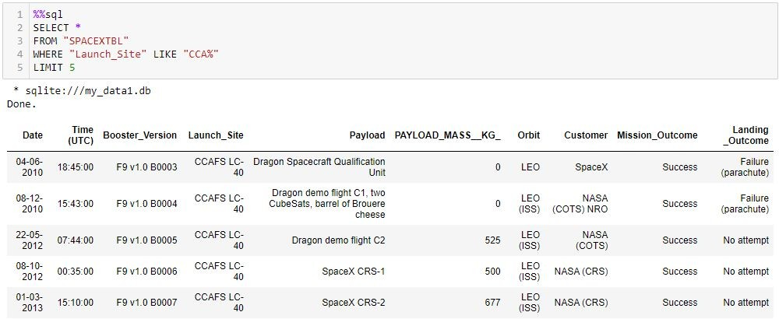
Launch Site Names Begin with 'CCA'
Task: Find 5 records where launch sites begin with `CCA`
Since there are several rows, the command LIMIT 5 was utilized to only show 5 records

Slide 26
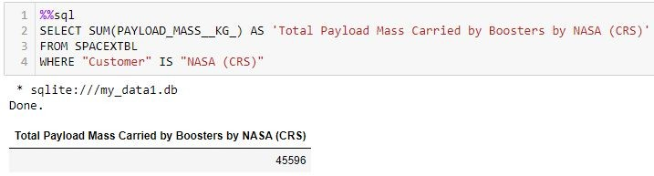
Total Payload Mass
Task: Calculate the total payload carried by boosters from NASA
Utilized the command SUM() to call the total payload

Slide 27
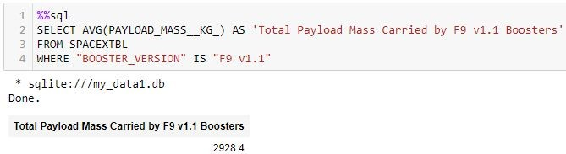
Average Payload Mass by F9 v1.1
Task: Calculate the average payload mass carried by booster version F9 v1.1
Utilized the AVG() command to call the average

Slide 28
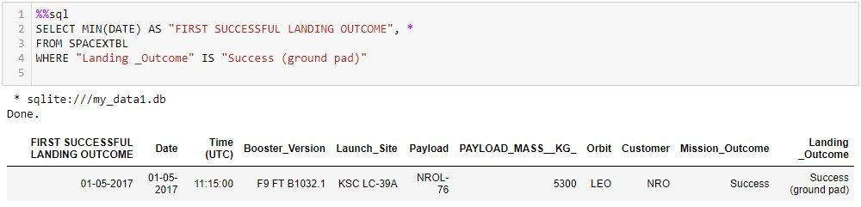
First Successful Ground Landing Date
Task: Find the dates of the first successful landing outcome on ground pad
Utilized the MIN() command to call the first successful landing and filtered using “ground pad” to avoid calling the very successful landing (which was not on ground pad)

Slide 29
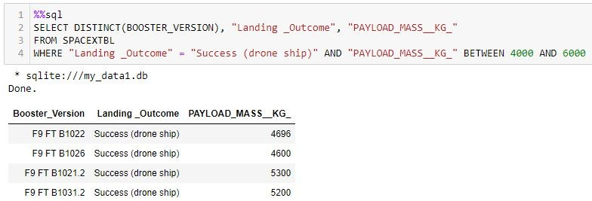
Successful Drone Ship Landing with Payload between 4000 and 6000
Task: List the names of boosters which have successfully landed on drone ship and had payload mass greater than 4000 but less than 6000 Kg
Utilized the command BETWEEN AND to call the needed mass

Slide 30
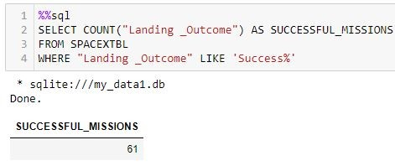
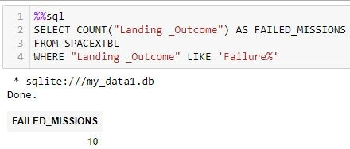
Total Number of Successful and Failure Mission Outcomes
Task: Calculate the total number of successful and failure mission outcomes
Utilized the commands WHERE and LIKE to filter only successful missions

Slide 31
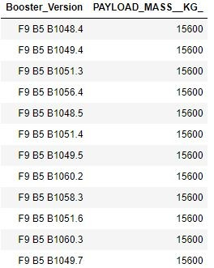
Boosters Carried Maximum Payload
Task: List the names of the booster which have carried the maximum payload mass
Utilized subquery method in order to use the command MAX() to get the maximum payload and the booster version
(SQL part not included to reduce visual noise)

Slide 32
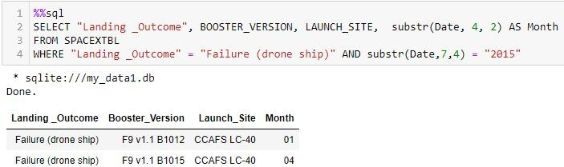
2015 Launch Records
Task: List the failed landing_outcomes in drone ship, their booster versions, and launch site names for in year 2015
Utilized the command substr(Date, n, n) in order to call the month

Slide 33
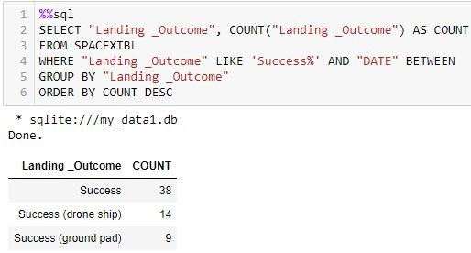
Rank Landing Outcomes Between 2010-06-04 and 2017-03-20
Task: Rank the count of landing outcomes (such as Failure (drone ship) or Success (ground pad)) between the date 2010-06-04 and 2017-03-20, in descending order
Utilized commands such as COUNT, WHERE, LIKE, BETWEEN, GROUP BY and ORDER BY in order to filter and group to reach the desired results

Slide 34

Section 3

Slide 35
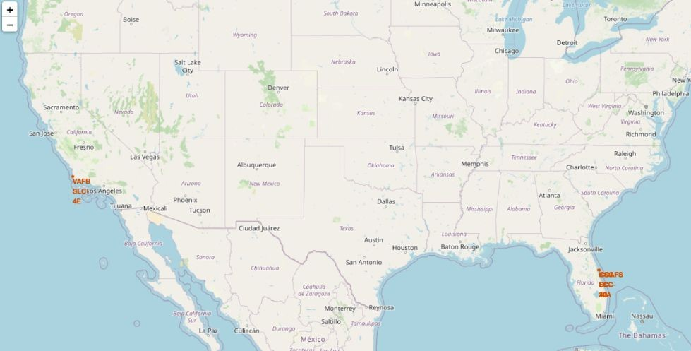
Falcon 9 SpaceX Launch Sites
So far, due to physics and cost, SpaceX has 2 main locations for their Falcon 9 launch sites: California and Florida, as shown in red on the map to the right.

Slide 36
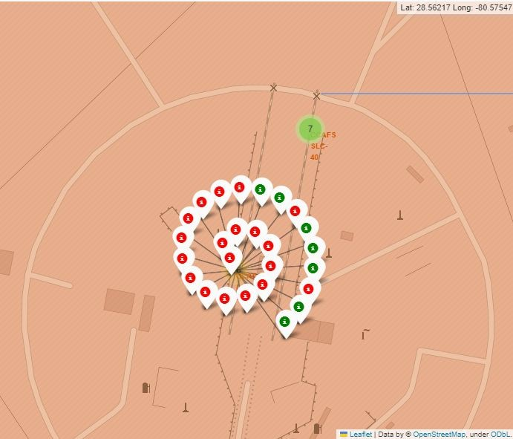
Folium color-coded expandable marker clusters
On the right, we have the Florida launch site. At the top, with a green circle and the number 7 inside, is CCAFS SLC-40. If you were to click on that number, it would open up its marker cluster, as shown at the bottom, at CCAFS LC-40.
Green marks are for successful landings
Red marks are for failed landings

Slide 37
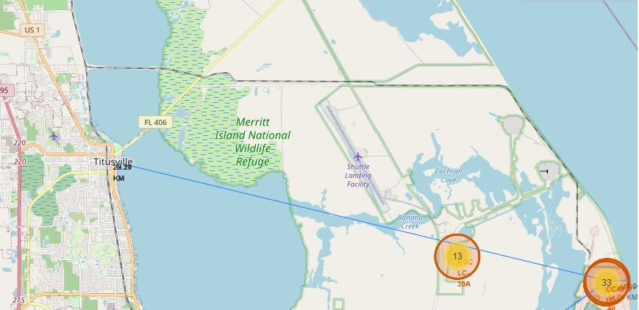
Folium Distance Plotting
Below is an example of Folium’s ability to plot a line using coordinates. In this example, a line from CCAFS, the busiest launch site in our analysis, is connected to its closest city, Titusville. With a population of about 50,000, it is only 29 KM, or 18 miles away from the launch site.

Slide 38

Section 4

Slide 39
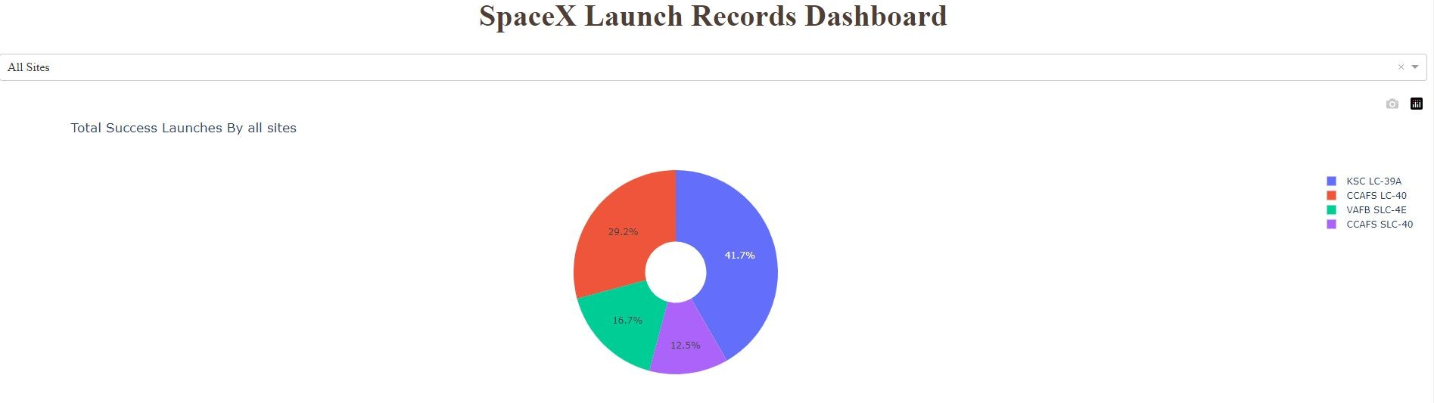
Plotly Dash: Success Count for All Sites
A pie chart, below, giving a sense of the amount of successful launches by launch site, with KSC LC-39A leads with 41.7% success rate.

Slide 40
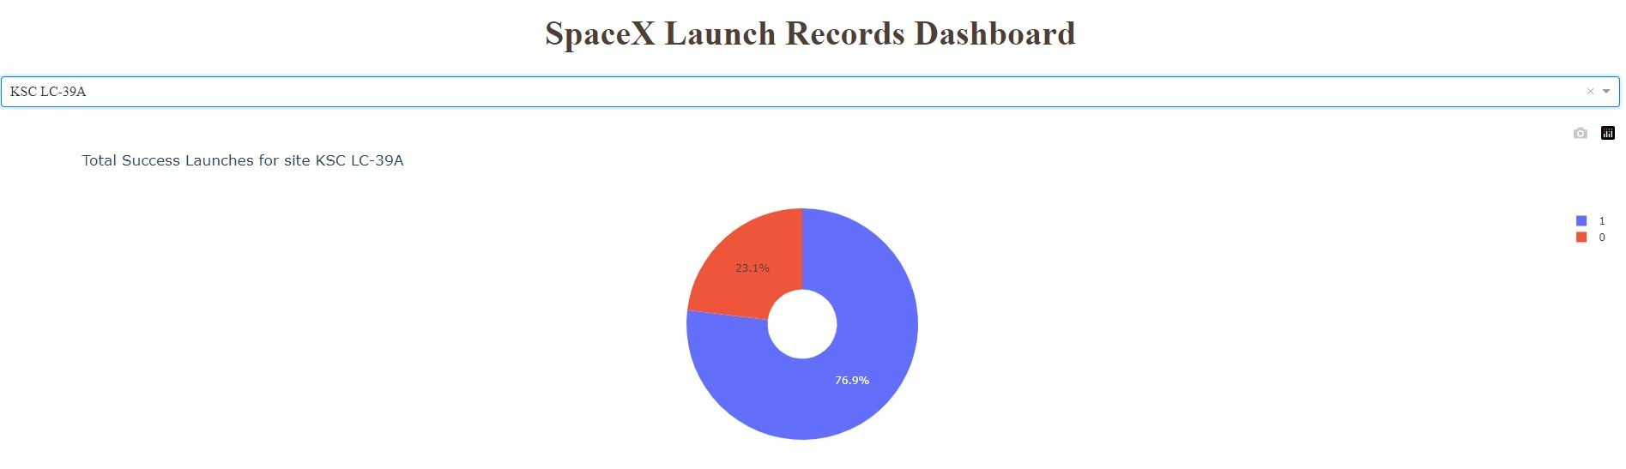
Plotly Dash: Highest Launch Success Ratio
We learned from the previous slide that KSC LC-39A leads with 41.7% success rate over all other sites. However, by clicking on the interactive menu and choosing this specific site, it reveals its own success ratio of 76.9%:

Slide 41
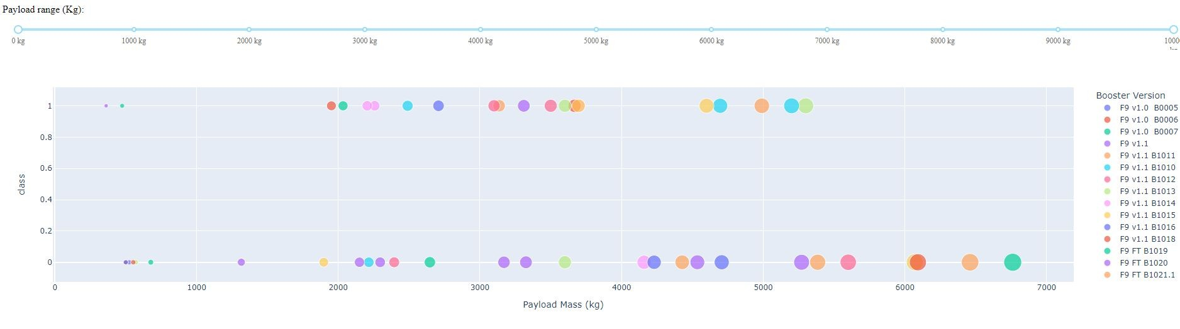
Plotly Dash: All Sites Payload vs Launch Outcome
Below, at the bottom section of the page, we can use the slider to choose the Payload range in Kg (here, the full spectrum has been selected) and its historical data on success rate, denoted with a “1” and failure as “0”. Note that most the high success rate is in between 2000 and 6000 Kg.

Slide 42

Section 5

Slide 43
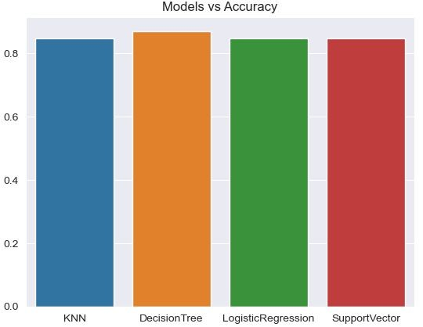
Classification Accuracy
Although all models were very close in accuracy, the Decision Tree model came out slightly ahead, as the bar graph on the right shows.

Slide 44
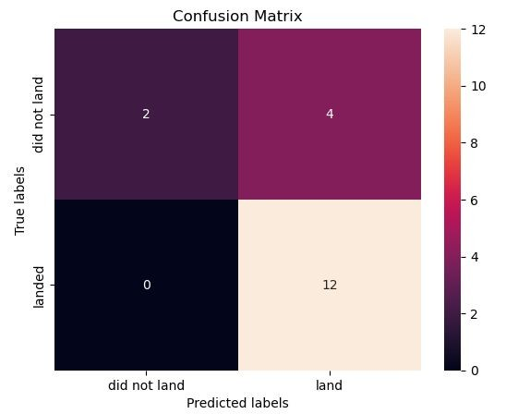
Confusion Matrix
In this Confusion Matrix diagram on the right we can see a pattern among all models: a very high False Positive of
12. However, in all other models, the
True Positives at 3, just below the Decision Tree score of 4. To top things off, the True Negative is 2 here, but all others were 3. With all that said, even though the accuracy was slightly higher, the Decision Tree is indisputably the model of choice for this project.

Slide 45
Conclusions
SpaceX data is readily and openly accessible, with a plethora of details to gather data from;
Most the high success rate missions had a payload in between 2000 and 6000 Kg;
All analyzed launch sites are at a good distance from major cities
The SpaceX Falcon 9 missions, in general, have been a success regardless of payload mass, orbit, or landing site (yes, even drone ships in the middle of the ocean)
The fact that the reusable rocket has a significant reduced cost compared to competitors, and such high success rate despite the factors mentioned above, it would be difficult to argue against SpaceX’s case
Among K-Nearest Neighbors, Support Vector Machine, Logistic Regression and Decision Tree models, the latter came out ahead with a 0.85 score
With all points above considered, we can conclude that the Falcon 9 rocket will land. Again.

Slide 46


